Slide 1
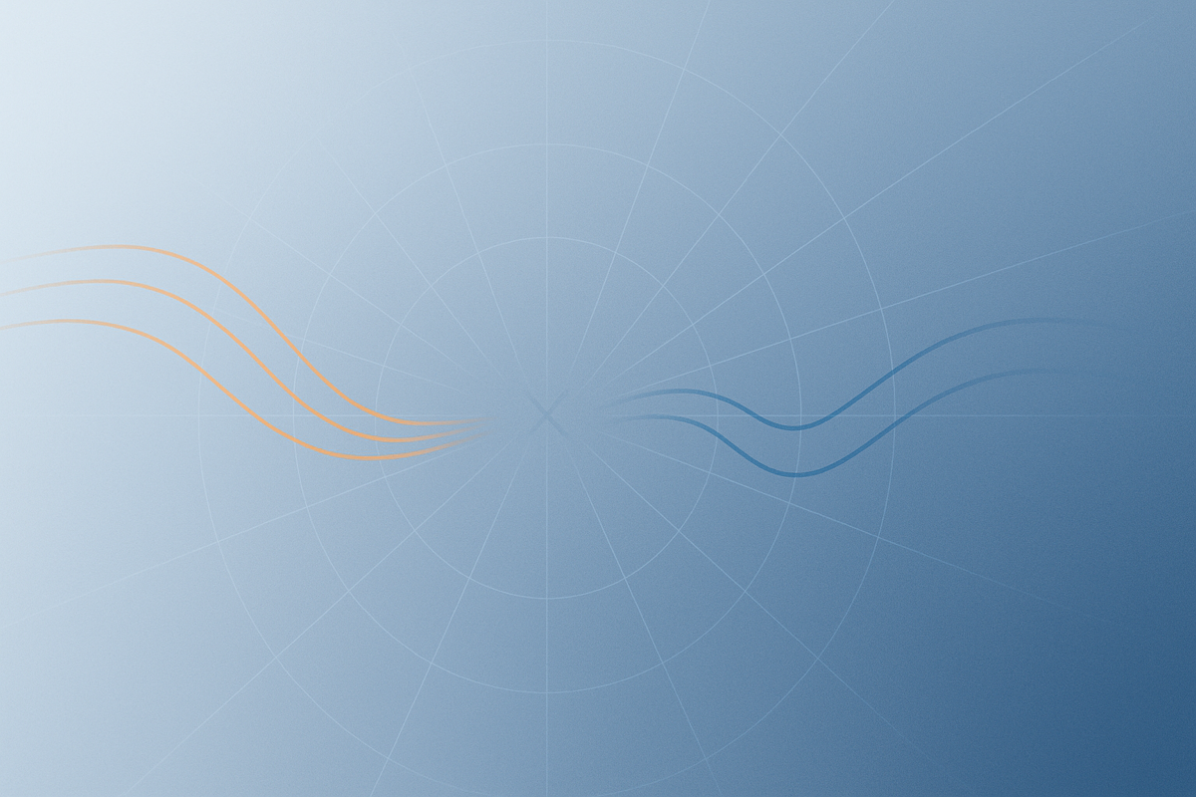



Graviton correlators in (A)DS from twistor space
Mariana Carrillo Gonzalez
Mathematical and Theoretical Physics Seminars
University of Hertfordshire

Slide 2
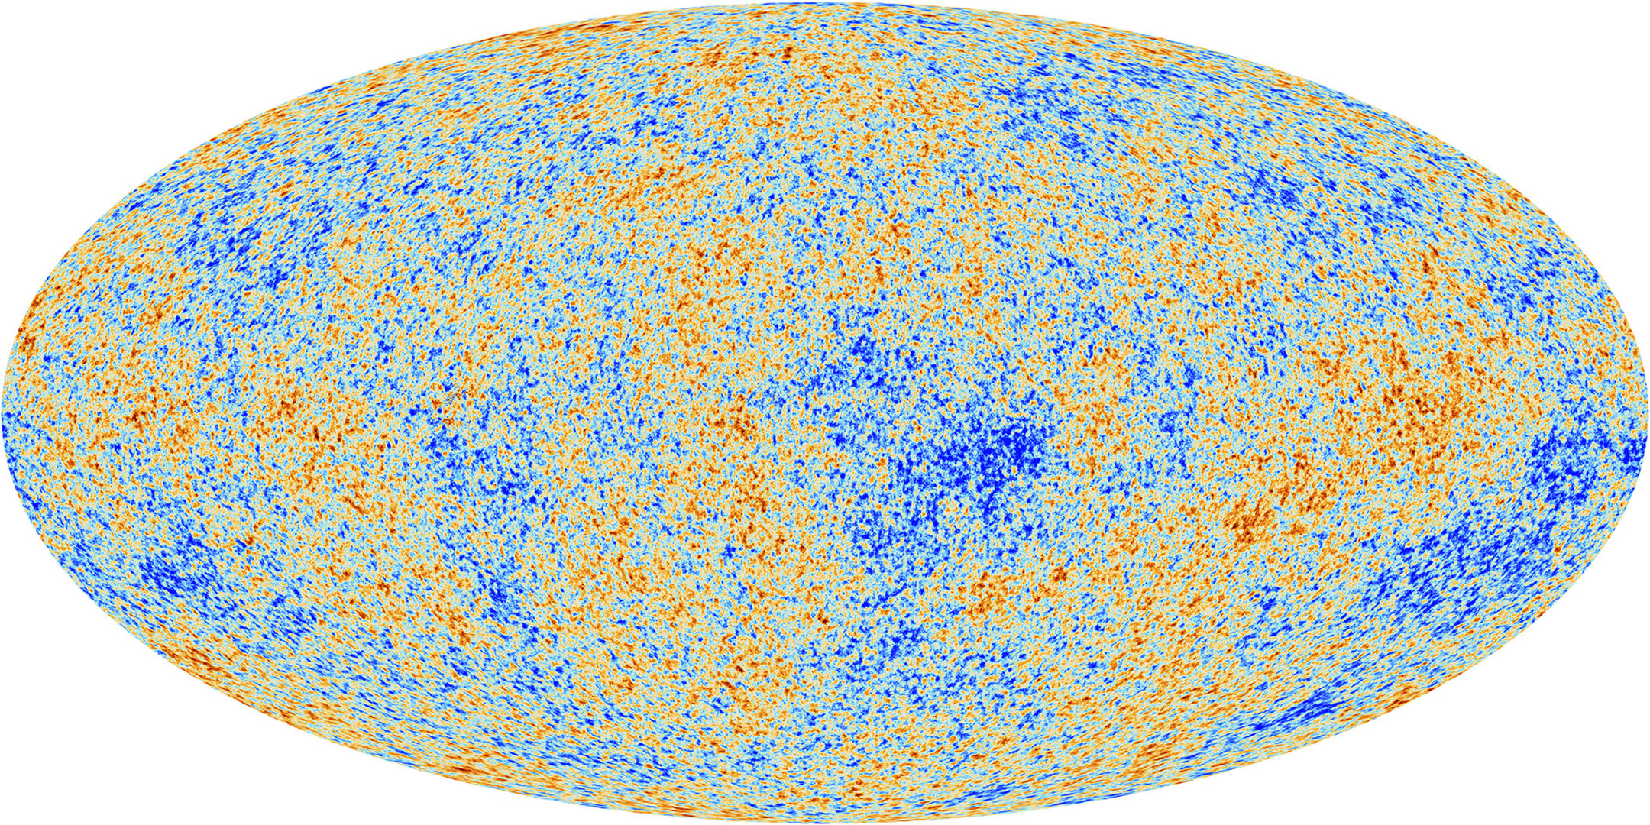
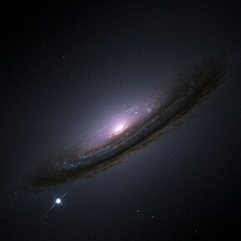
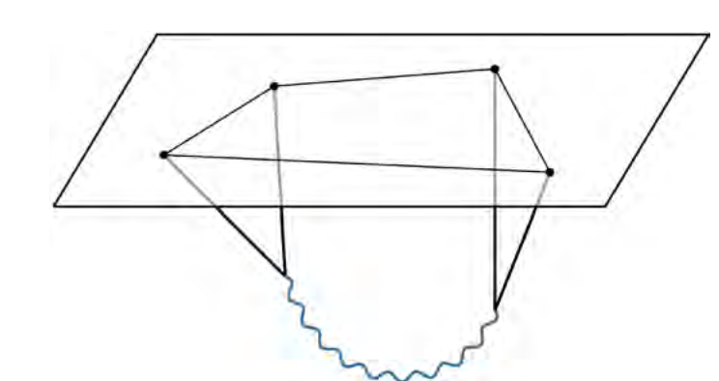
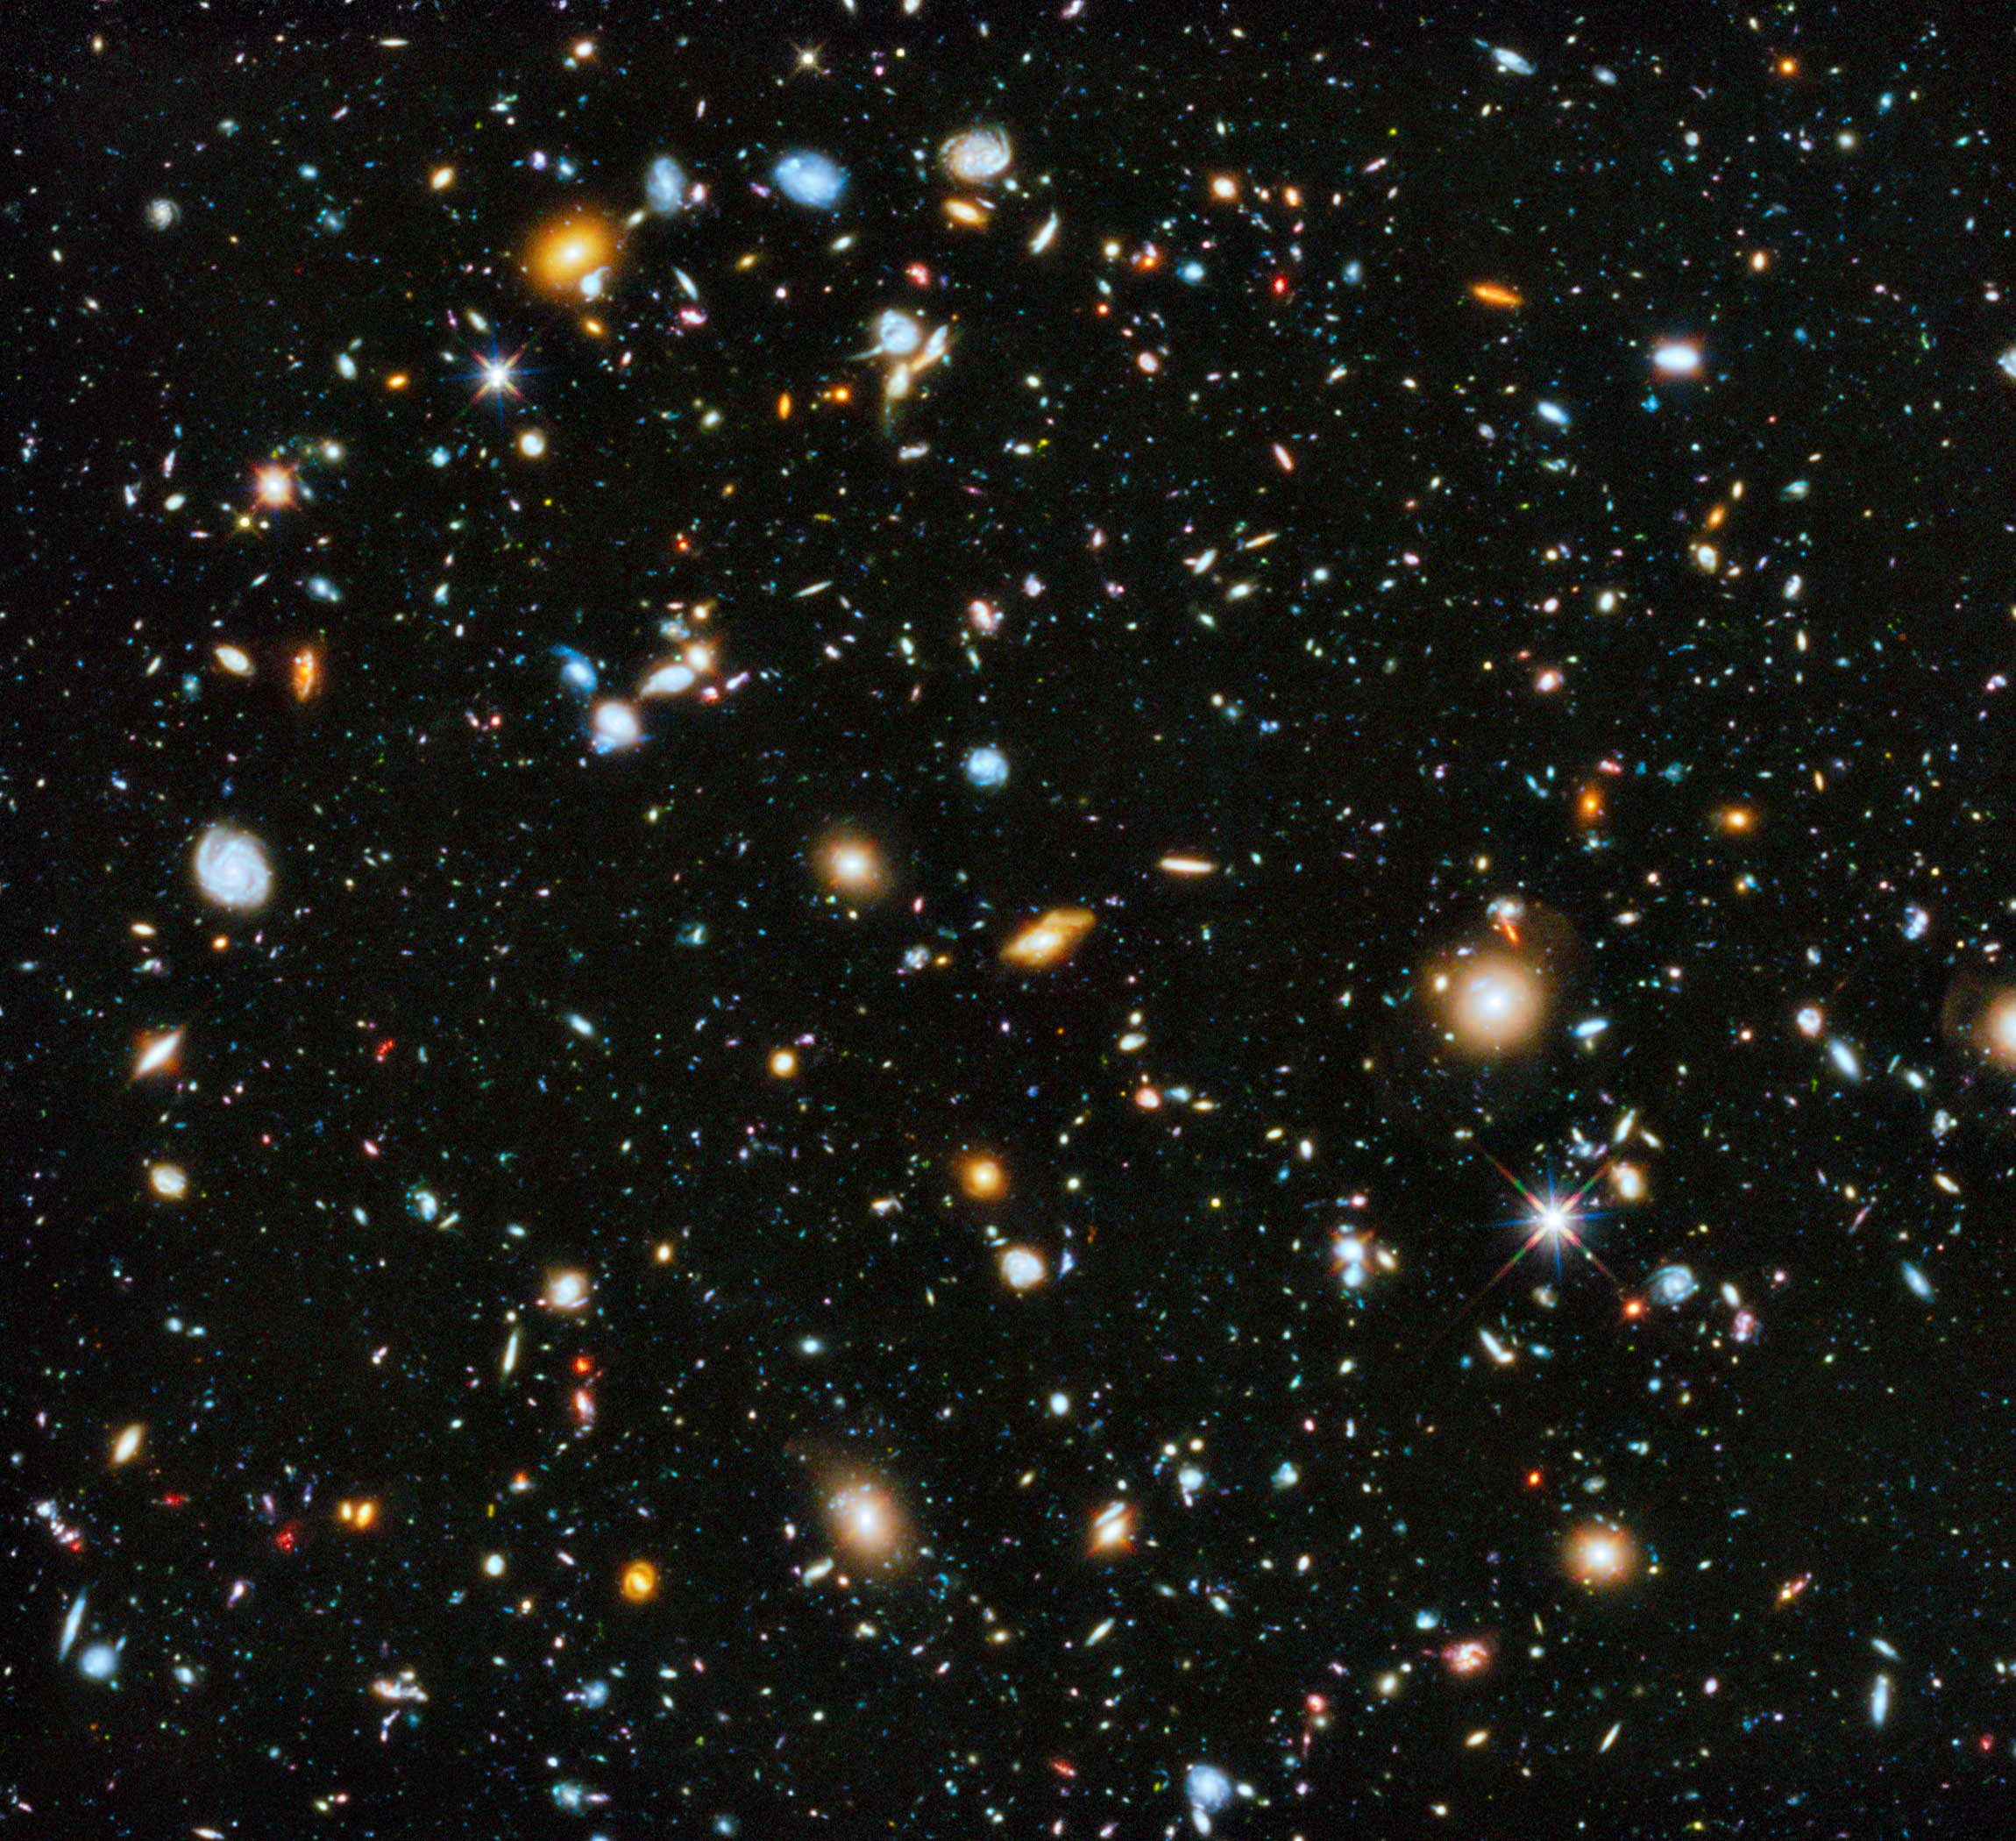
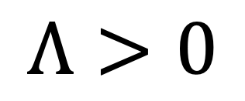
Physics in curved spacetimes
$$Λ>0$$

Slide 3
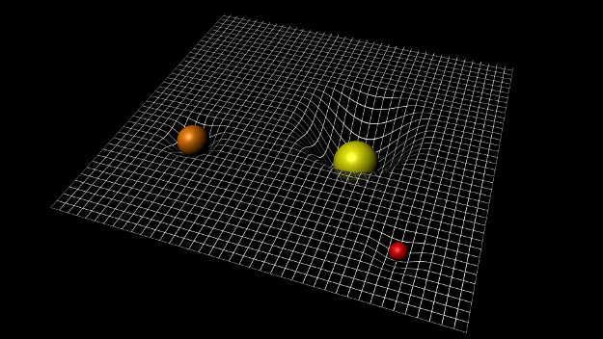
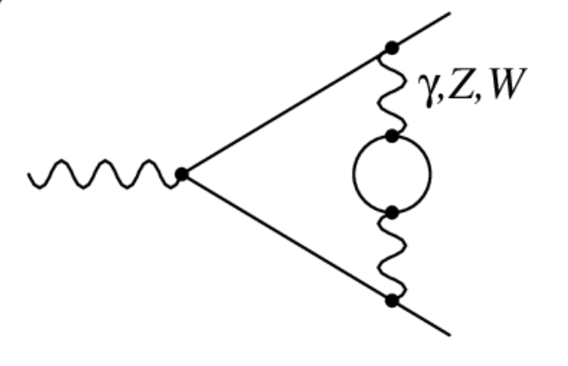
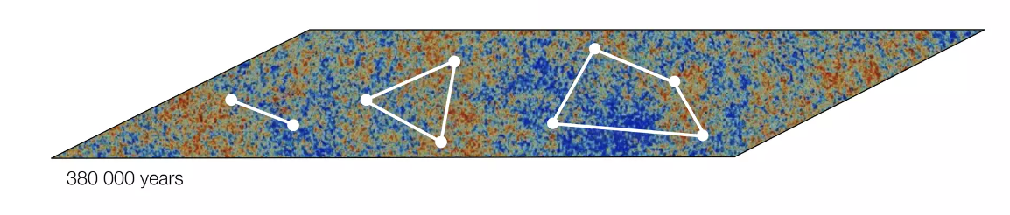
We usually work at small curvature / weak gravity
Large curvature / strong gravity is much harder!
Perturbation theory & EFT
Scattering amplitude methods
Perturbation theory & EFT
No S-matrix → correlators

Slide 4
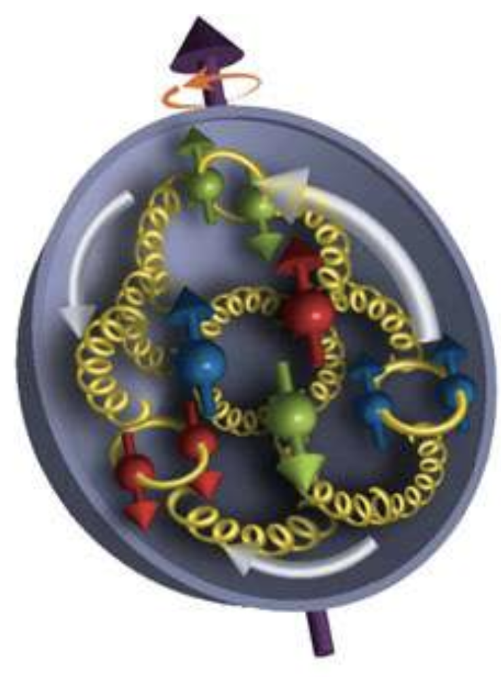
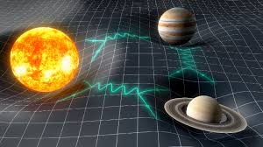
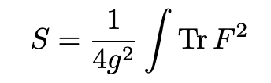
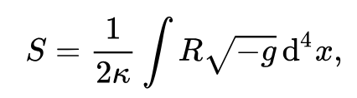
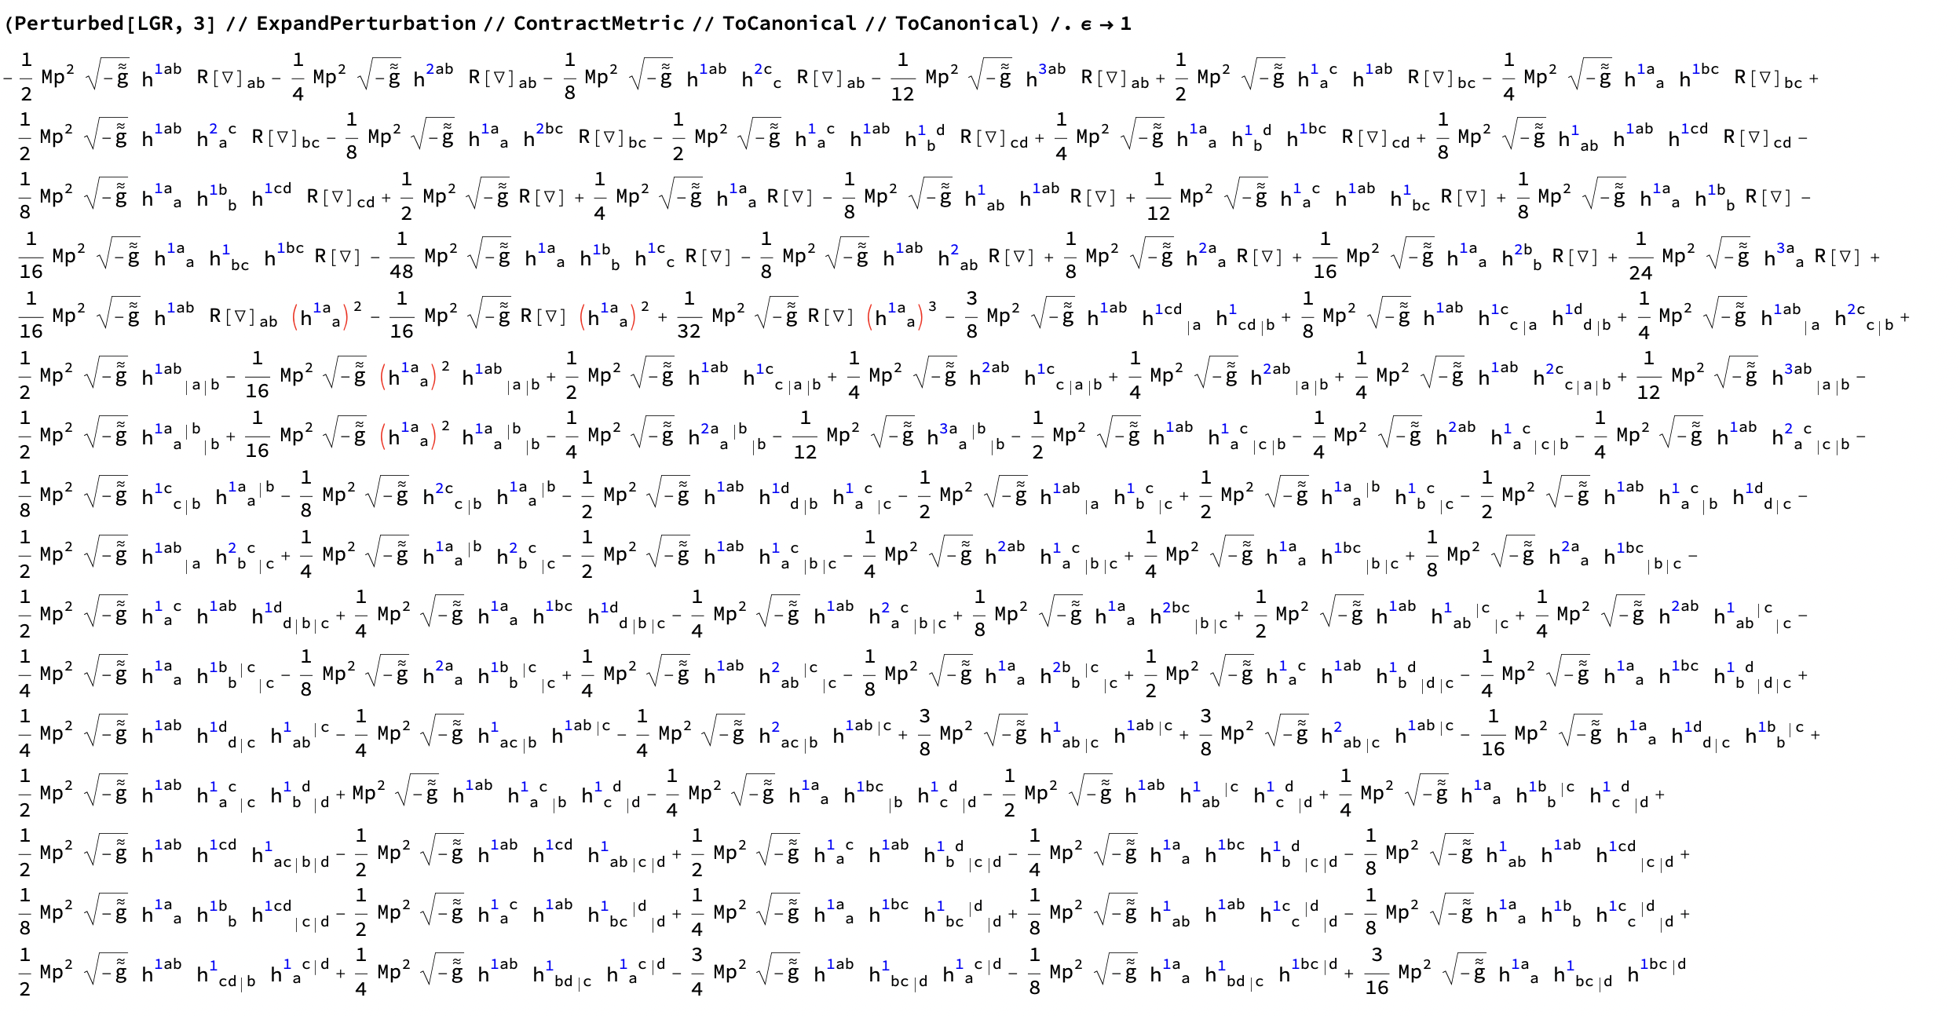
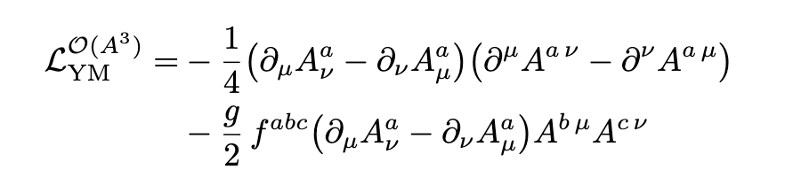
Lessons from flat space
Gauge theories
Gravity
Is there a better description?

Slide 5


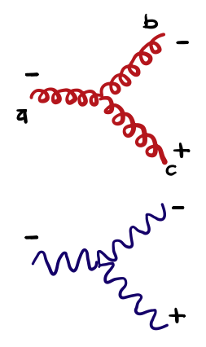



Better variables in flat space: spinor-helicity
Use different representations of the Lorentz group
Identity + Pauli matrices
Massless $p^{2}=0$
On-shell helicity amplitudes

Slide 6

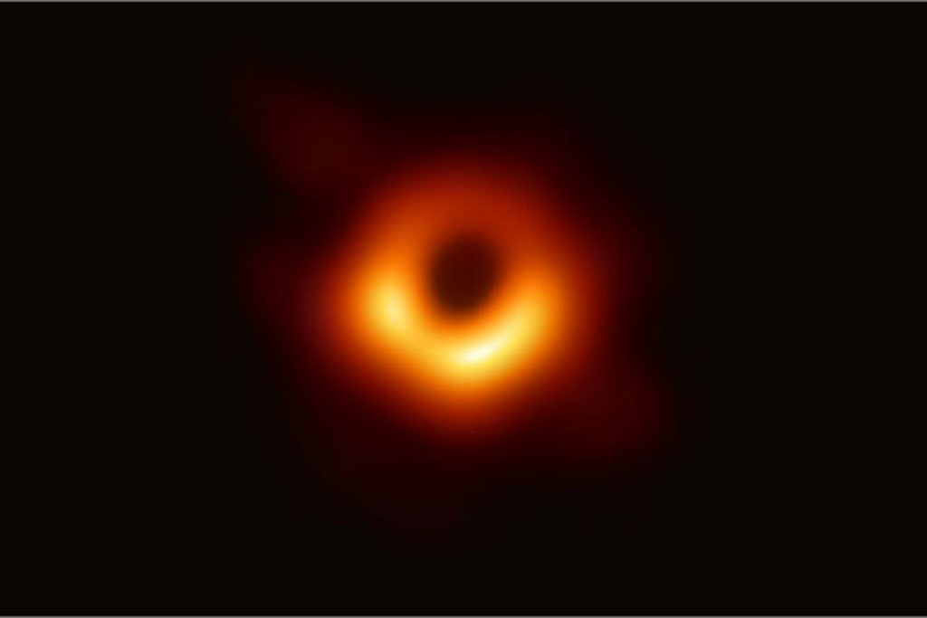






What do we learn from the double copy?
Breakdown of gravity EFT (divergences in loops)
Precision calculations for gravitational waves
HOPE: Precision calculations of cosmological correlators
Double Copy
kinematics $×$ kinematics
color $×$ kinematics
color $×$ kinematics
color $−$ kinematics duality
$$\sim$$
color algebra
kinematic algebra

Slide 7
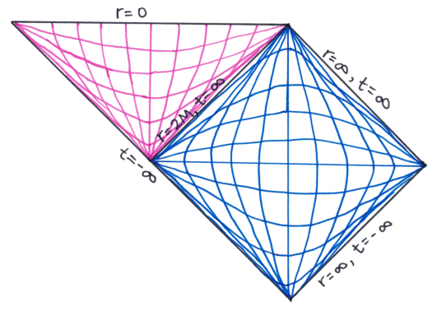
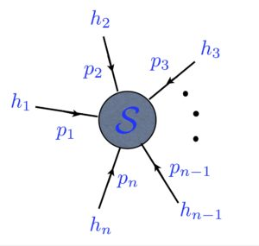
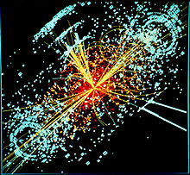
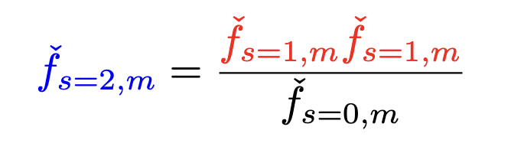
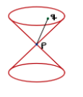

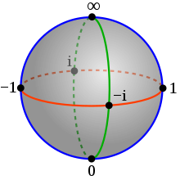
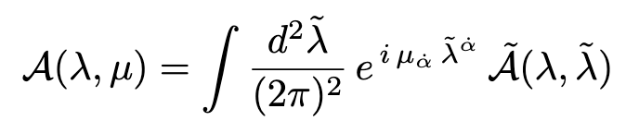

Double copy in different spaces
Inverse Fourier transform
Coordinate space: classical solutions + eom
Twistor space
Momentum space: Amplitudes
Penrose transform
Half- Inverse Fourier transform

Slide 8







(a)DS correlators from twistor space
2410.23342: Beetar, MCG, Jaitly, Keseman
2510.00096: MCG, Keseman

Slide 9
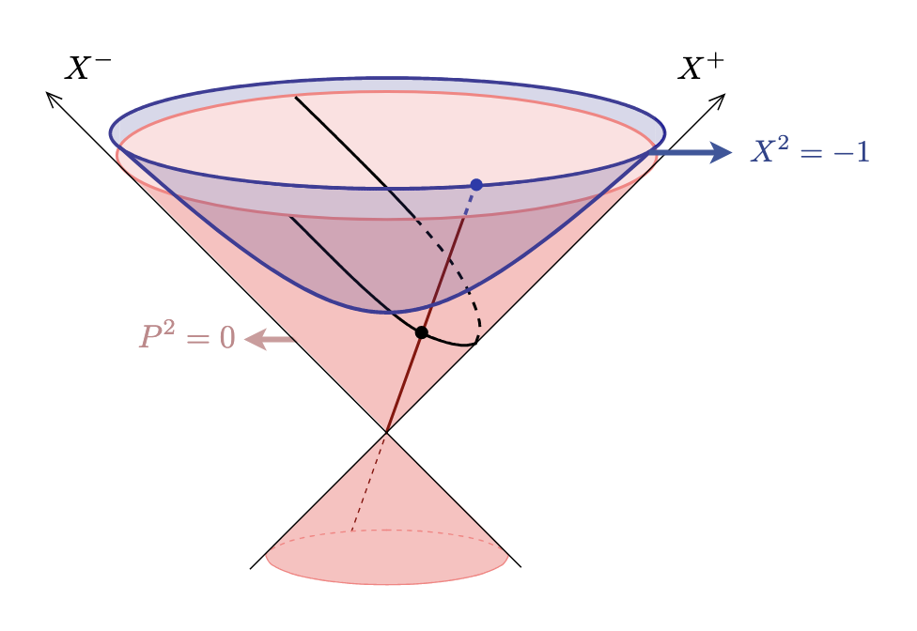

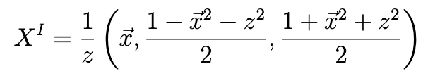
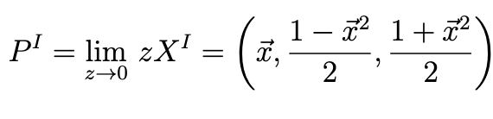
Embedding Space
D+2 dim.
Linear Lorentz
Poincare coordinates
D+1 dim.
D dim.
Non-linear Conformal

Slide 10



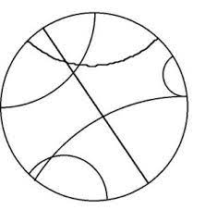
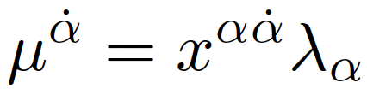

Mini-twistor space
Geodesics in 3d hyperbolic space (EAdS)
Bulk point in 4d embedding space
Boundary points
Isometries of geodesics
Isometries of geodesics
Incidence relation
Hitchin; Jones, Tod

Slide 11
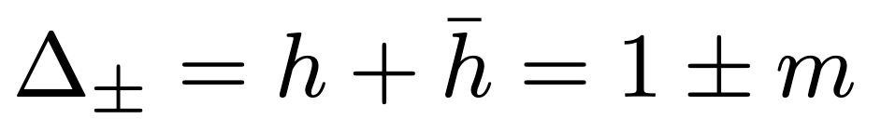
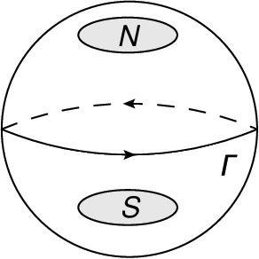

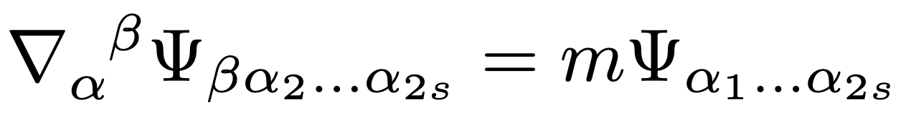

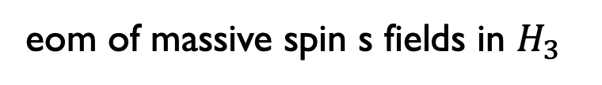
Cech cohomology class rep.
Isometries of geodesics
Isomorphism:
Penrose transform
eom of massive spin s fields in $H_{3}$

Slide 12
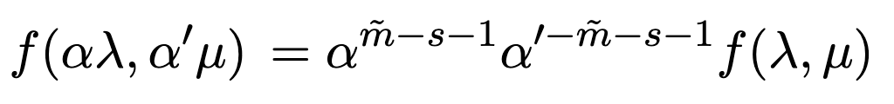

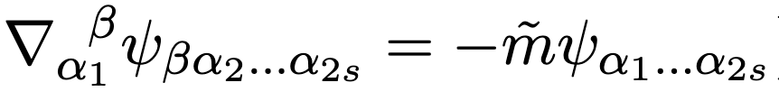
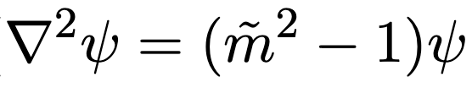
Penrose transform
Čech cohomology class representatives

Slide 13
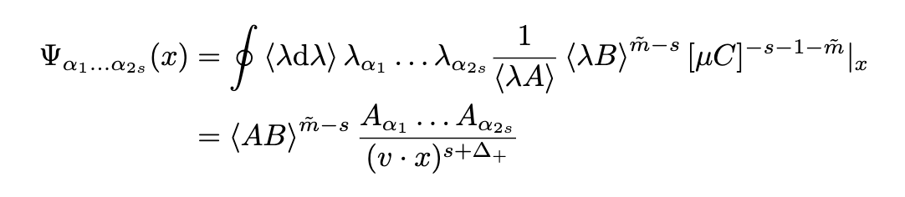
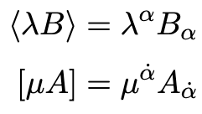
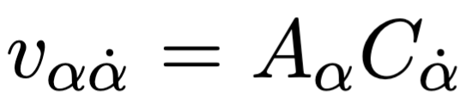

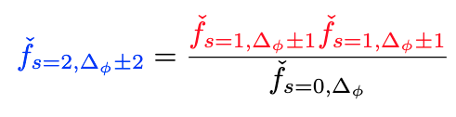
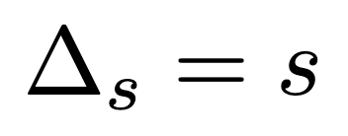
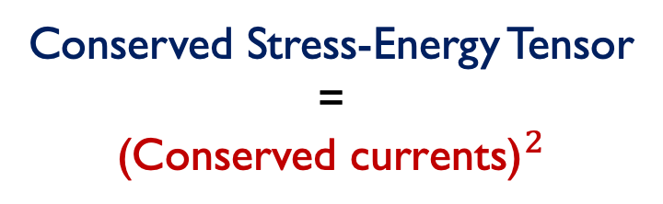
Bulk-to-Boundary Correlators
(Beetar, MCG, Jaitly, Keseman)
Dimensional reduction of 4d plane waves
Boundary point
Bulk point
Double Copy
Conserved Stress-Energy Tensor
=
$${\text{(}\text{Conserved} \text{currents}\text{)}}^{2}$$

Slide 14
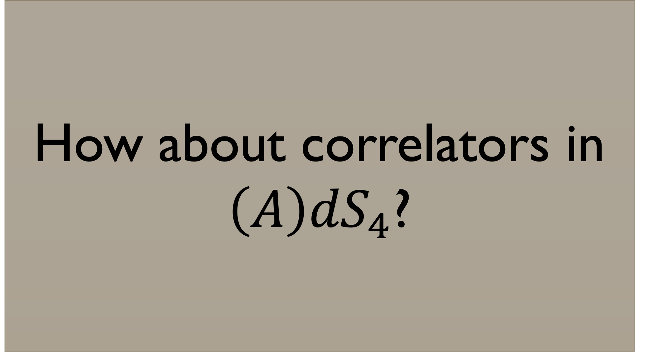
How about correlators in ${\left(A\right)dS}_{4}$?

Slide 15
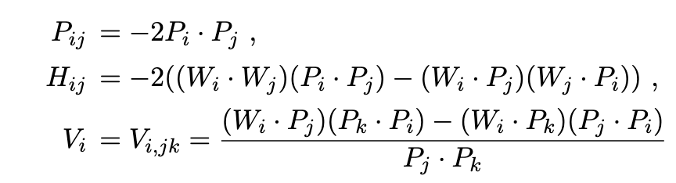

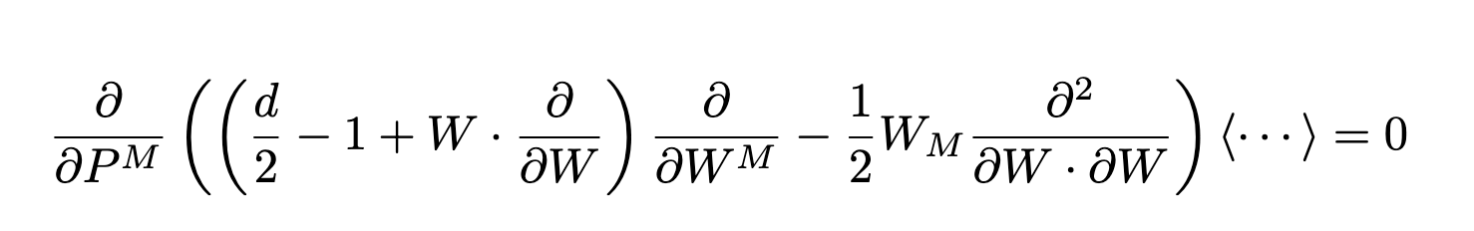
Embedding Space Correlators
Costa, Penedones, Poland, Rychkov
Building blocks
Scalings
Conservation

Slide 16
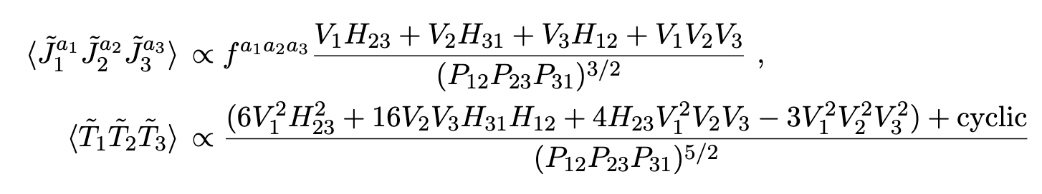
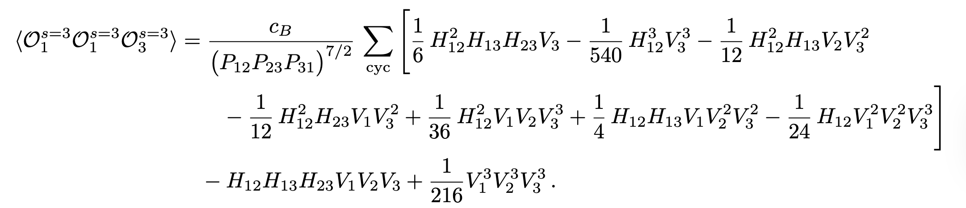
Three-Point Embedding Space Correlators
for Conserved Currents

Slide 17


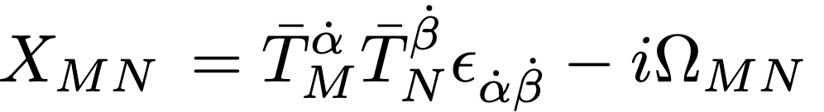


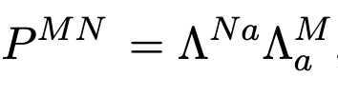
Better variables in (A)DS space?
Bispinors for AdS and CFTs (Binder, Freedman, Pufu)
SO(5) ~ SP(4)
Conserved currents still require imposing a differential equation:
Can conservation be automatic?
AdS: 5D massive spinor helicity $→$ l.g. = SO(4)~SU(2) X SU(2)
3d CFT: 5D massless spinor helicity $→$ little group = SO(3)~SU(2)

Slide 18
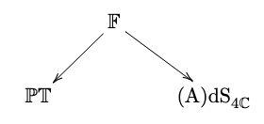






${(A)DS}_{4} (AMBI−)$Twistor space
6d embedding space
SO(6) ~ SU(4)
5d embedding space
SO(5) ~ SP(4)
Choice of infinity twistor:
$$I_{MN}{=Ω}_{MN}$$
Breaks conformal sym. down to AdS isometries
In 5d, one can lower and raise indices with $Ω_{MN},$ but not in 6d:
Twistors $≠$ Dual twistors
Complexification of variables used in
(Baumann, Mathys, Pimentel, Rost)
Boundary limit

Slide 19






Cech cohomology rep.
Scaling of conserved currents
in boundary limit
Isomorphism:
Penrose transform
eom of anti-self-dual spin s fields in ${\left(A\right)dS}_{4}$

Slide 20





${(A)DS}_{4}$penrose transform
Self-dual and anti-self-dual fields
Boundary limit gives conserved currents

Slide 21




2-point correlators
(MCG, Keseman)
Bulk: self-dual /anti-self-dual
Boundary: conserved currents
Extension to all conformal dimensions

Slide 22





3-point boundary correlators
(MCG, Keseman)
$F^{3}$, $W^{3}$
YM, GR
Double copy
Complexification of results in (Baumann, Mathys, Pimentel, Rost)

Slide 23

3-point correlators: Ward identities
(MCG, Keseman)
The YM, GR correlators satisfy the inhomogeneous Ward Identity
In twistor space
Only satisfied for complexified reps.

Slide 24

4-point correlators
Related to those found via the Cosmological Grassmannian (Arundine, Baumann, Gordon Lee, Pimentel, Rost)

Slide 25
CONCLUSIONS
Penrose transform: isomorphism between twistor rep. and eom solutions
Building blocks for rep: cleanly track symmetries and their breaking
Double copy arises naturally
Ward Identities are straightforward
Twistor space (A)dS₄
CFT₃ correlators (2‑, 3‑pt)
Next: Fermions, n-point, higher dim., expansion around self-dual sector, recursion relations,
cosmological Grassmannian in 4d

